Slide 1

SDET Course
Design Patterns - Template Method

Slide 2
3 Types of Design Patterns
Creational
Singleton
Builder
Prototype
Factory Method
Abstract Factory
Structural
Adapter
Composite
Proxy
Flyweight
Bridge
Facade
Decorator
Behavioral
Strategy
Observer
Command
Memento
State
Template Method
Mediator
Chain of Responsibility
Interpreter
Visitor
Iterator

Slide 3
Agenda
Description
Diagram
Code sample (Java)
Use cases

Slide 4

Description
Introduction - Building a House Using Templates

Slide 5
Description
The Template Method design pattern is a behavioral design pattern that defines the program skeleton of an algorithm in a method, deferring some steps to subclasses. This pattern allows subclasses to redefine certain steps of an algorithm without changing the algorithm's structure. The template method within a parent class contains a series of method calls that each perform a step of the algorithm. Some of these steps are implemented directly in the template method, while others are abstract or virtual and must be implemented in subclasses. This design pattern is particularly useful for algorithms with a fixed sequence of steps, but where the details of one or more steps may vary depending on the specific context or data. By leveraging the Template Method pattern, software developers can encapsulate varying behaviors within a subclass while ensuring that the overarching algorithm remains unchanged and consistent.

Slide 6
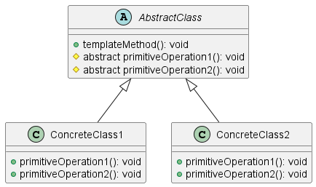
Class Diagram

Slide 7
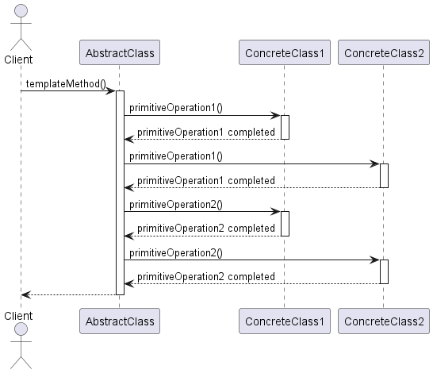
Sequence Diagram

Slide 8
Code Sample

Slide 9
Use cases
General
Software Build Processes: Preprocess, Compile, Link, Package
Educational Content Delivery
This presentation?
Maven: Validate, Compile, Test, Package, Verify, Install, Deploy
In Test Automation
All types of testing - it is a lifecycle design pattern
The Retry Mechanism

Slide 10
Happy Coding

